Slide 1

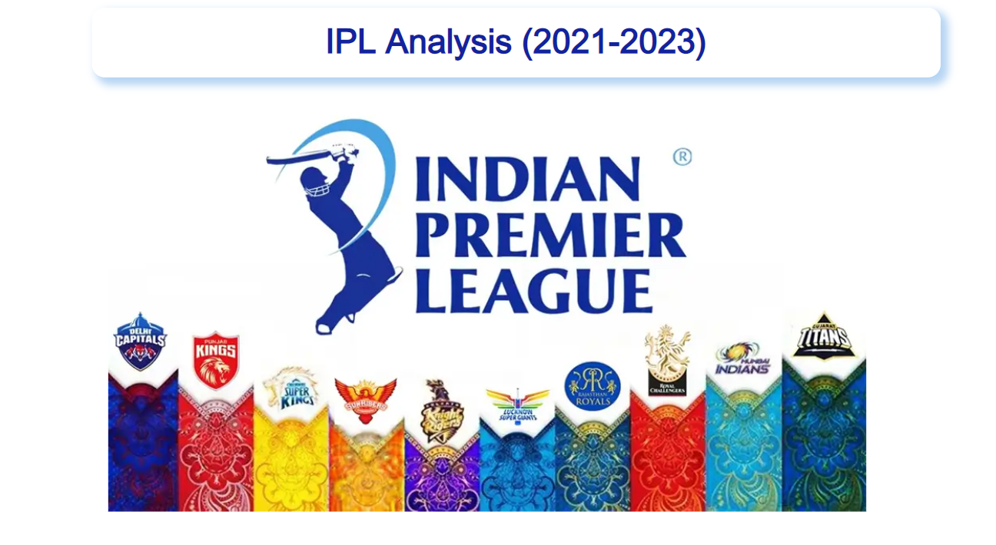

Mentorness | 2024
Presentation by Sagar Patil
Data Analyst Internship

Slide 2

INTRODUCTION
The goal of this Power BI project is to analyse IPL (Indian Premier League) cricket data to gain insights
into team and player performance, match outcomes, and various key metrics related to both batting
and bowling. The analysis will be carried out using data from multiple related tables, providing a
comprehensive view of the tournament's dynamics.
Mentorness | 2024
Presentation by Sagar Patil
Data Analyst Internship

Slide 3


INDEX
01
Top 10 batsmen
05
Top 10 bowler Avg
02
Top 10 batsmen Avg
06
Top 10 bowler Economy Rate
03
Top 10 batsmen Strike Rate
07
Top 5 Player with Boundary %
04
Top 10 bowler
08
Top 5 Bowler with Dot %
09
Team Win %

Slide 4
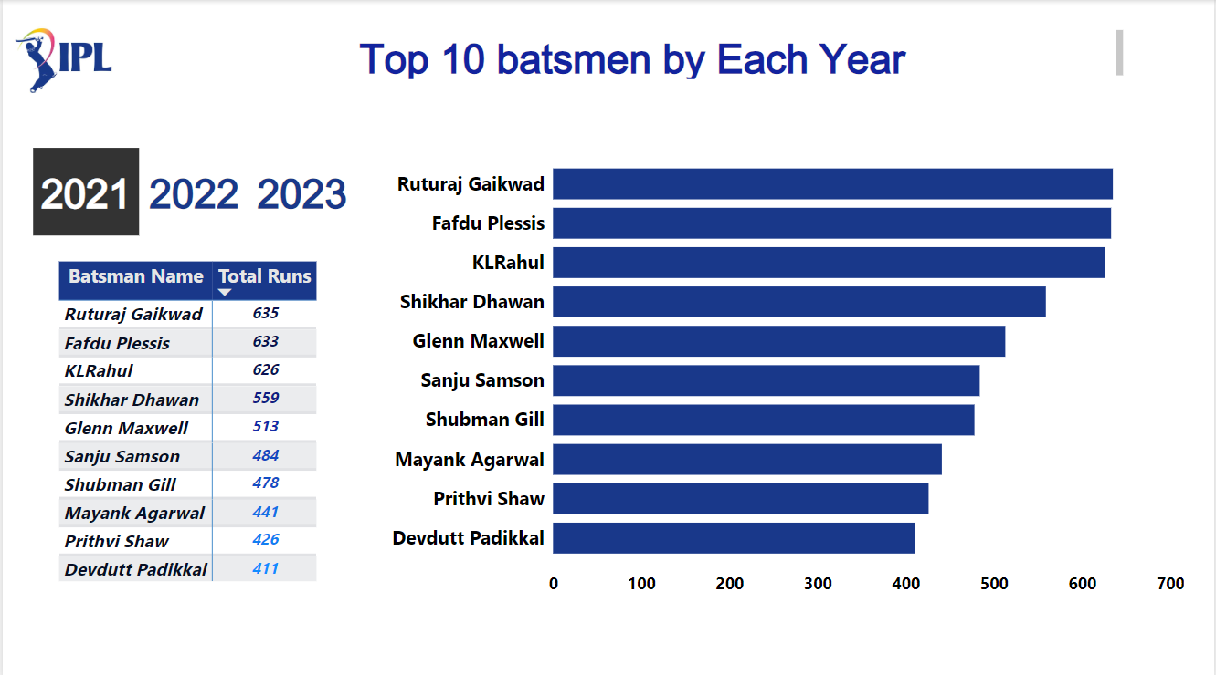

Slide 5
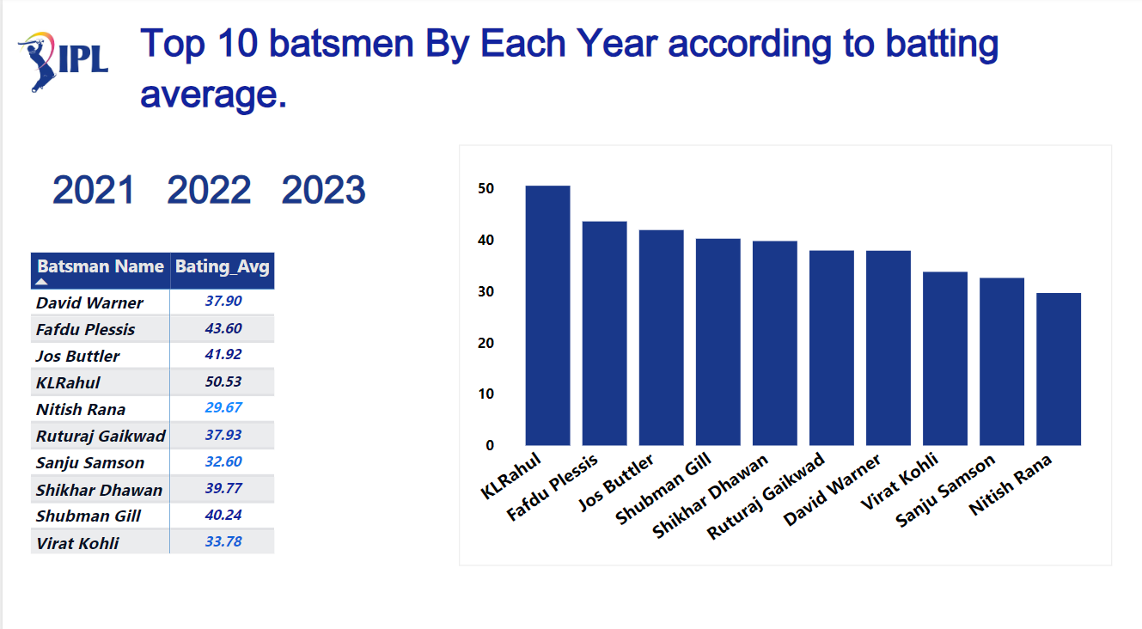

Slide 6
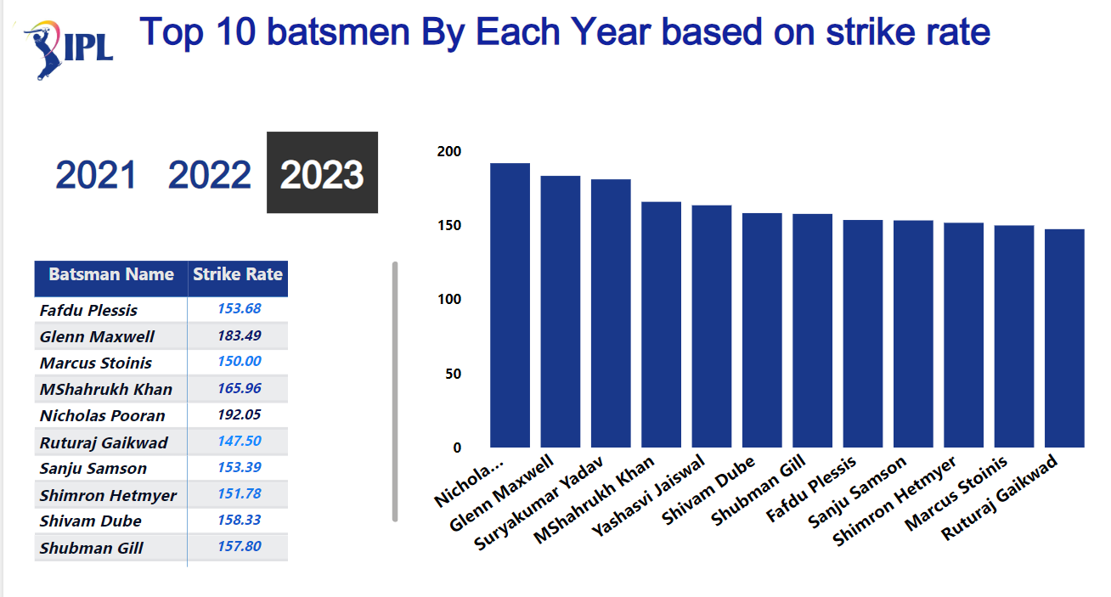

Slide 7
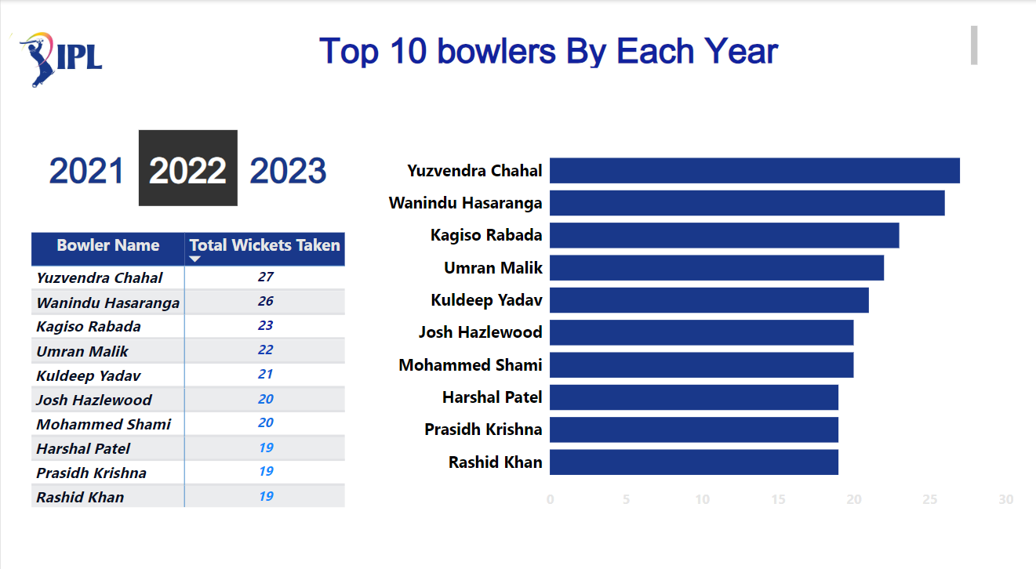

Slide 8
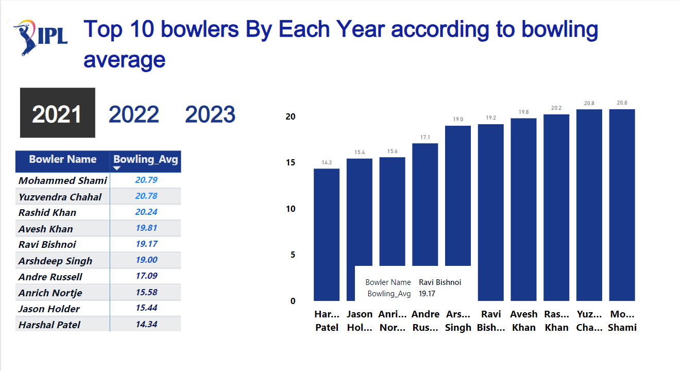

Slide 9
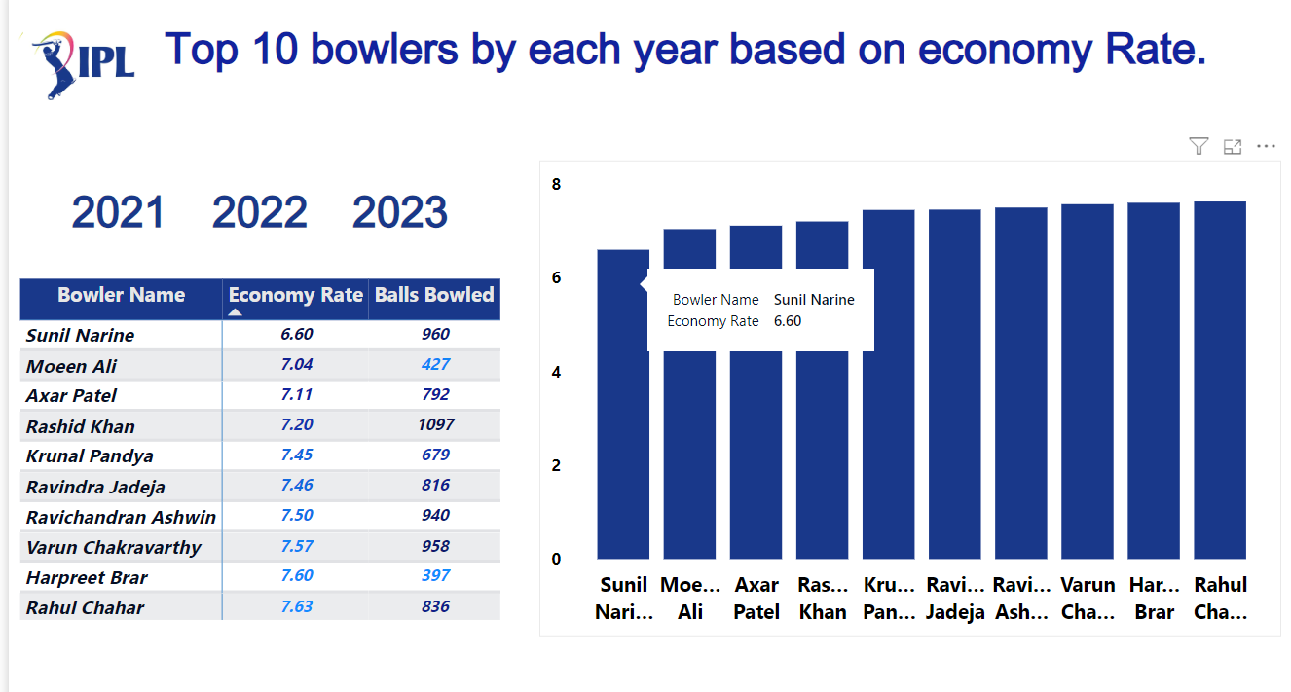

Slide 10
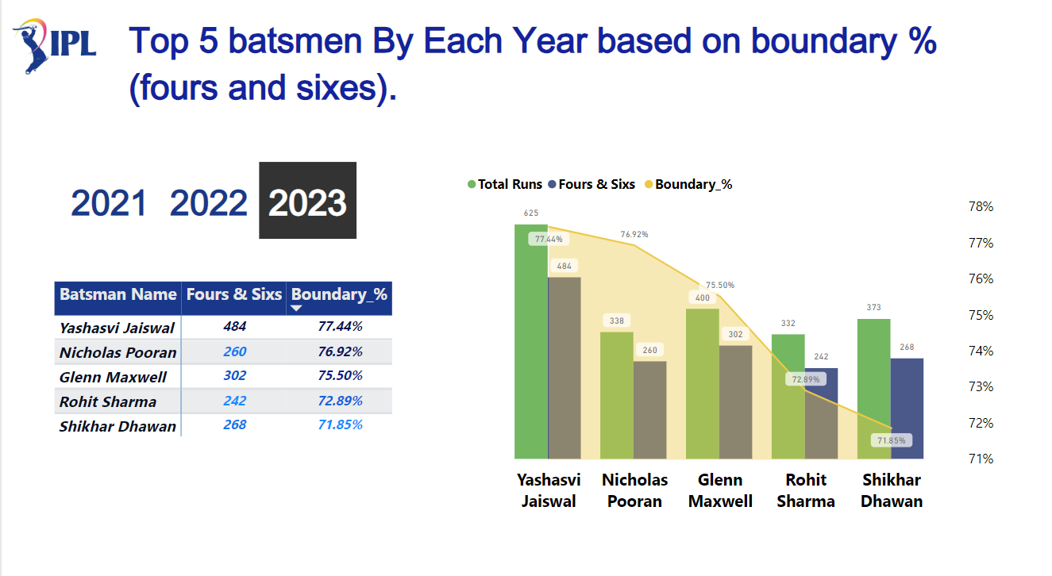

Slide 11
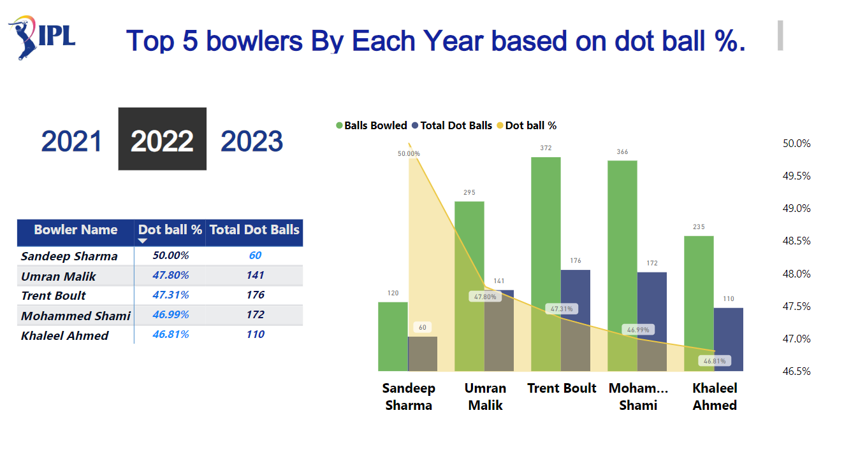

Slide 12
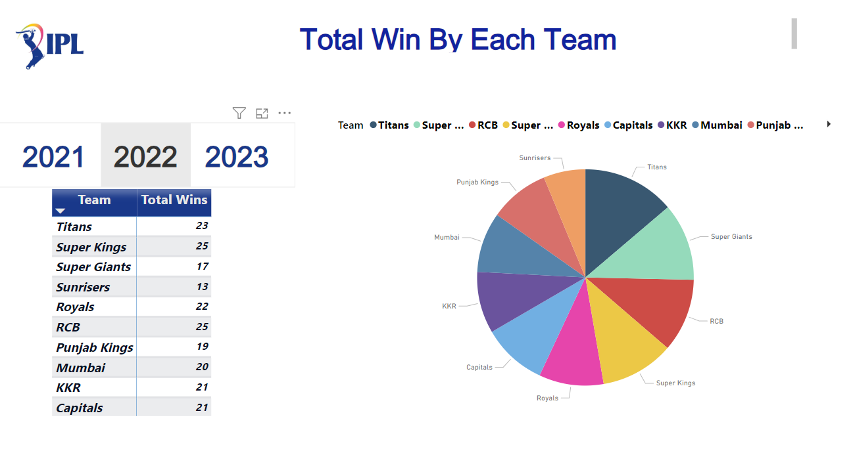

Slide 13

Thank You

